Slide 1
XFLR5 Methods and Their Application in “Constraints on the Wing Morphology of Pterosaurs”
By: Colin Parker

Slide 2
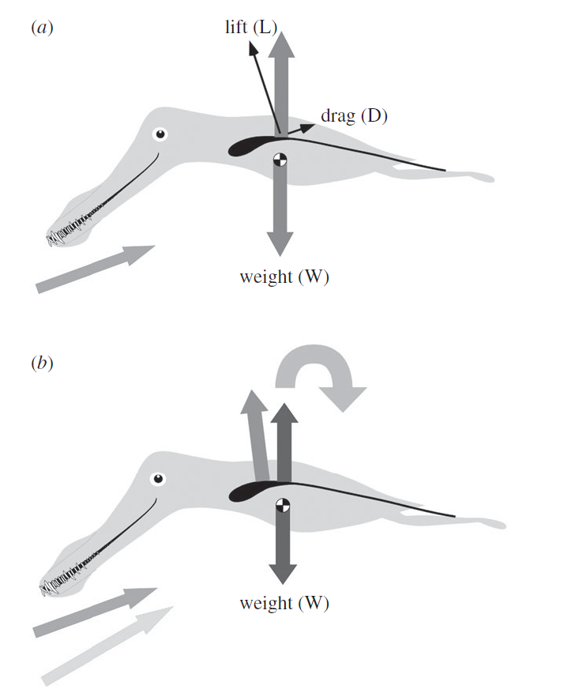
Longitudinal Stability Analysis

Slide 3
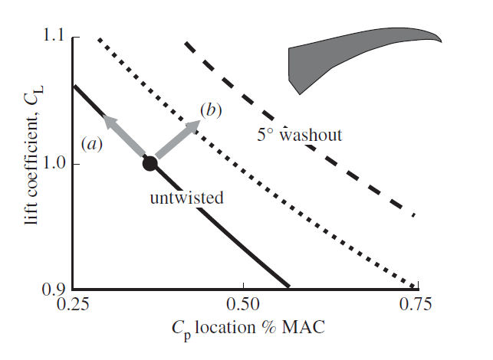
Effects of Washout

Slide 4
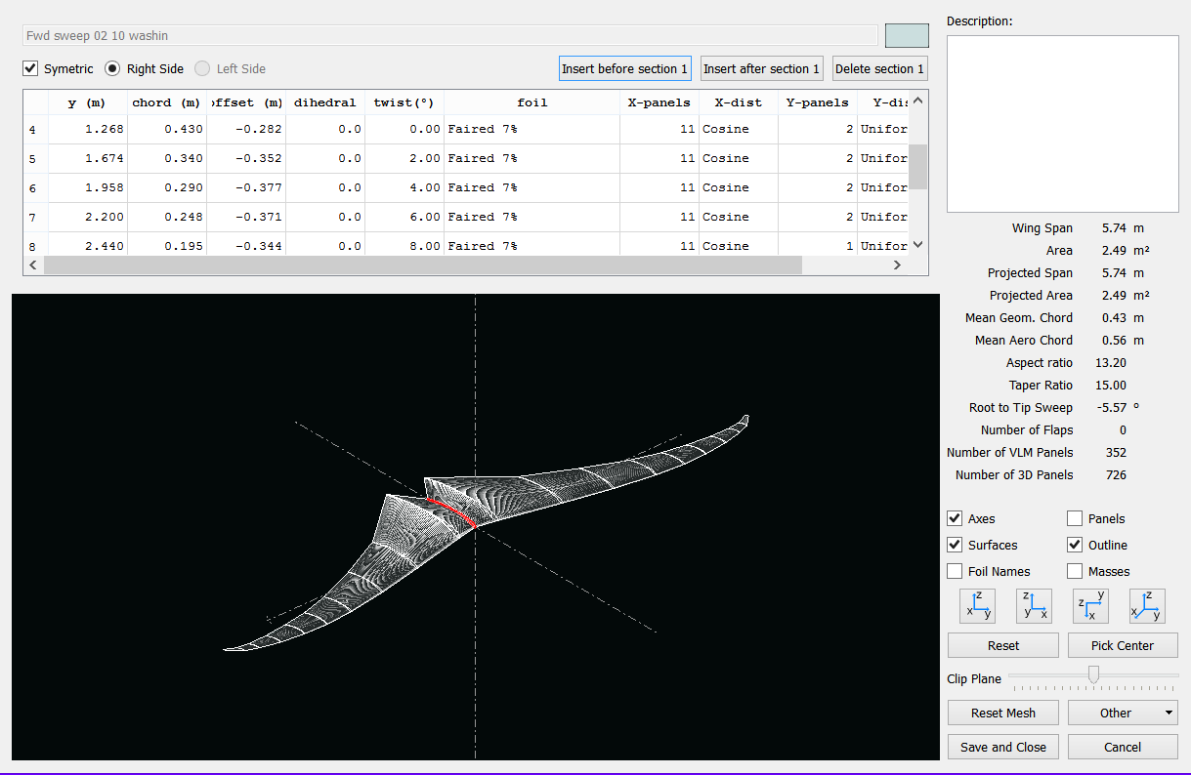
XFLR5

Slide 5
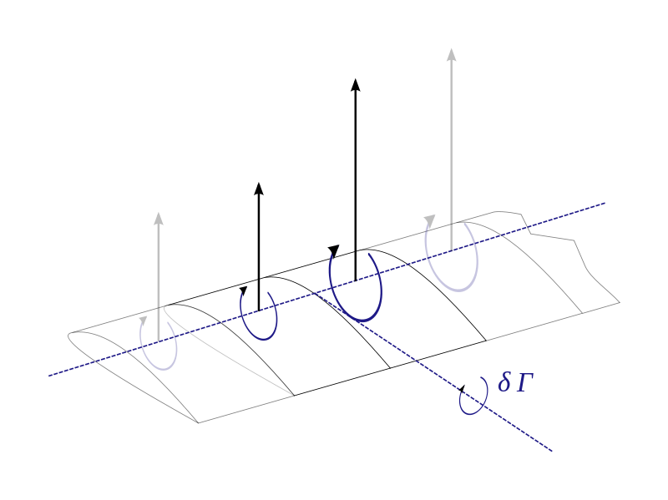
LLT Lifting Line Theory
Kutta_Joukowski
Biot-Savart
Helmholtz Theorem
The strength of a vortex filament is constant along its length
A vortex filament cannot end in a fluid: must extend to infinity or form a closed path
Effective angle of attack
Repeat

Slide 6
LLT
Limitations
Does not account for sweep
Does not account for dihedral
Inviscid
Must have high Aspect Ratio

Slide 7
VLM Vortex Lattice Method

Slide 8
VLM 1

Slide 10
VLM2

Slide 12
3D Panel Method

Slide 13
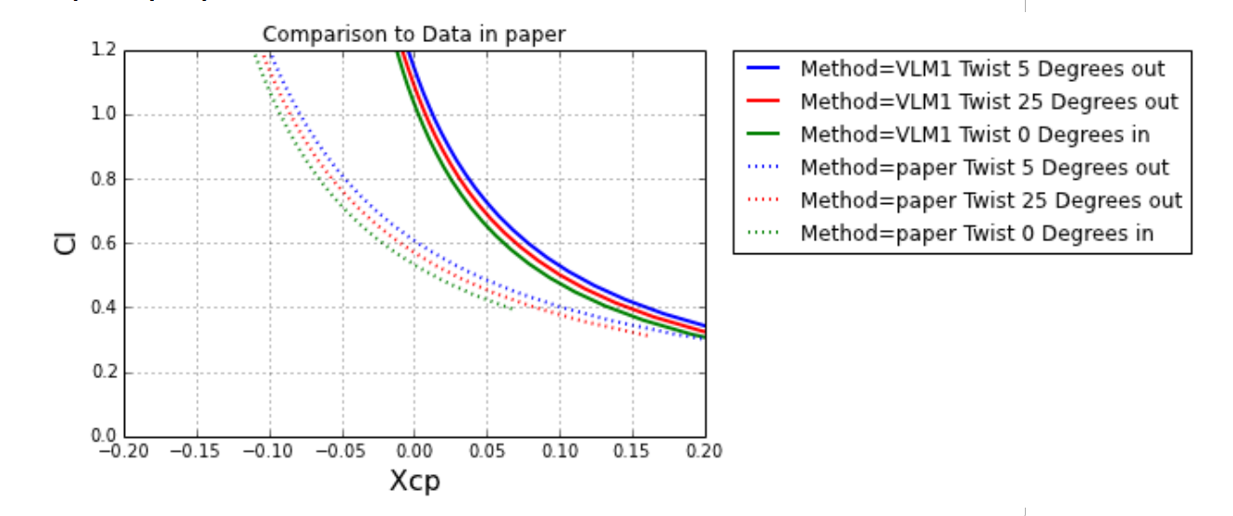

Slide 14
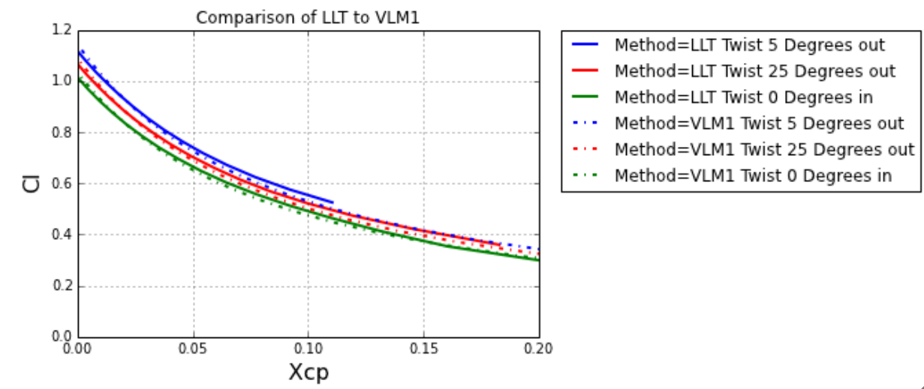

Slide 15
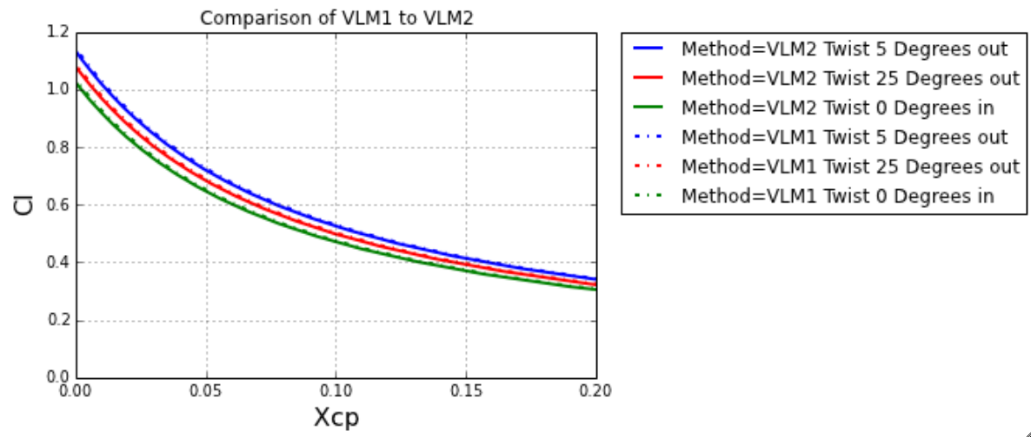

Slide 16
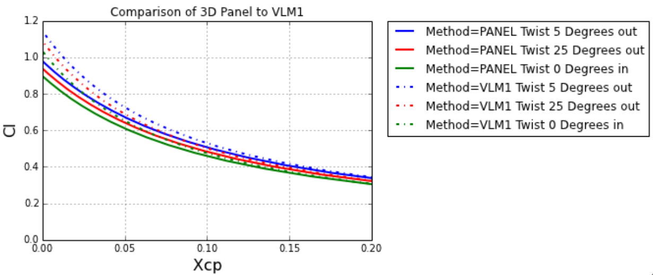

Slide 17
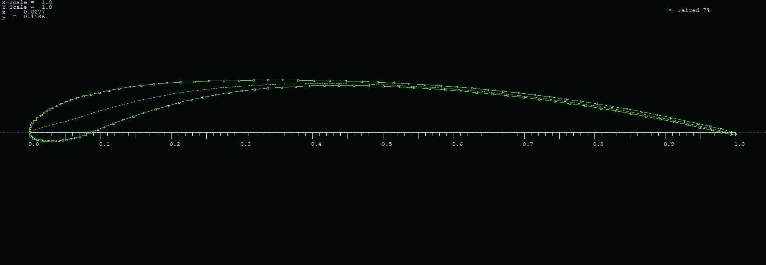
Airfoil Shape

Slide 18
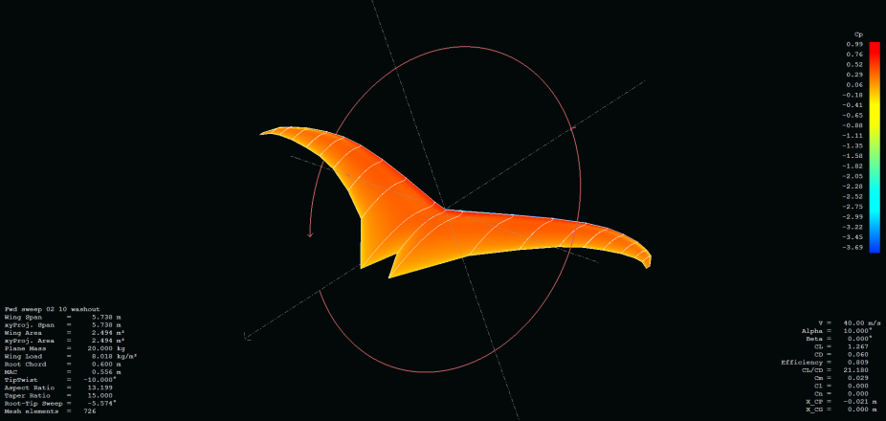
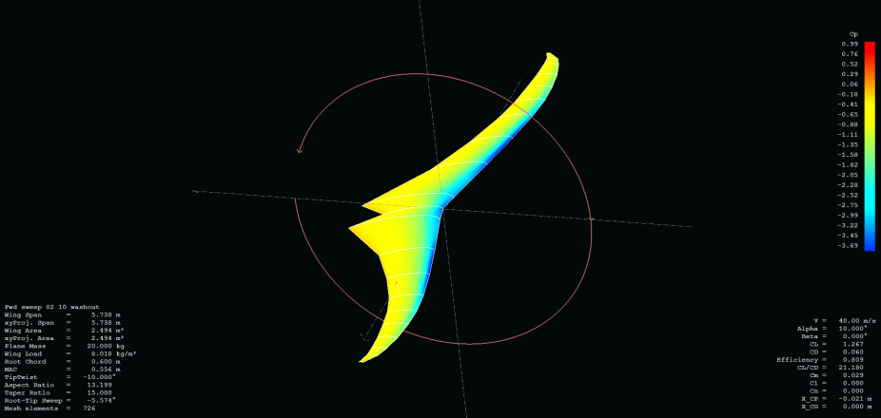
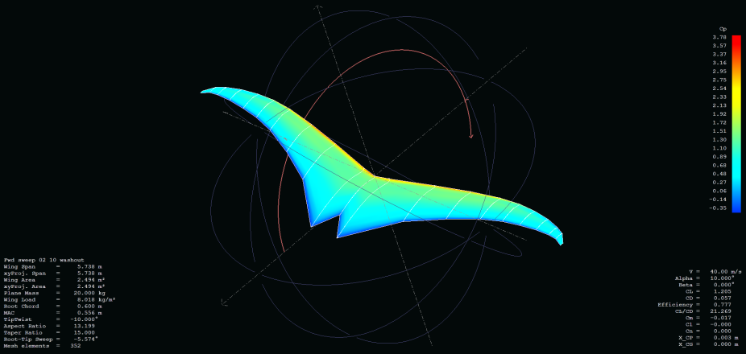
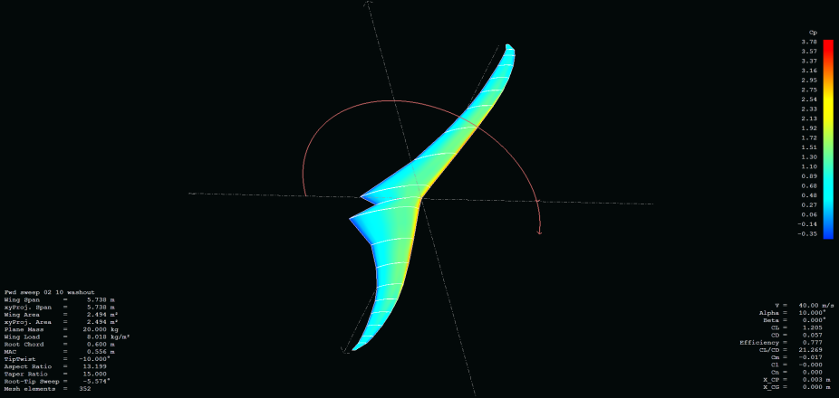
Cp Distribution
3D Panel
VLM1

Slide 19
Conclusions

Slide 20
Question?

